Slide 1
Successful Growth Strategies in the Government Marketplace
How to go after the RIGHT opportunities for your business

Slide 2
Other Workshops Dates
September 16 – Milwaukee
September 17 – Green Bay
September 22 – Wausau
September 24 – Lac du Flambeau
September 29 – Racine
October 1 – Milwaukee
October 6 – Madison
October 8 – La Crosse
October 13 – Milwaukee
October 14 – Viroqua

Slide 3
Supporting Partners
African American Chamber of Commerce of Wisconsin
American Indian Chamber of Commerce of Wisconsin
Brown County Public Library
Greater Green Bay Chamber
Great Lakes Inter-Tribal Council, Inc.
Hispanic Chamber of Commerce of Wisconsin
Juneau County Economic Development Corporation
LaunchBox of Racine
Milwaukee Urban League, Inc.
National Association of Minority Contractors
Native Diversification Network Procurement Technical Assistance Center
Vernon Economic Development Association
Wausau Region Chamber of Commerce
Western Dairyland
Wisconsin Department of Administration
Wisconsin Department of Economic Development
Wisconsin Department of Transportation
Wisconsin Department of Veterans Affairs
Wisconsin Indian Business Alliance
Wisconsin Women's Business Initiative Corporation
Wisconsin SBDC – La Crosse

Slide 4
What We Will Be Talking About Today
Business Opportunities
Federal Government
State Government
Local Government
Tribal Government
Strategic Plan
Overcoming Obstacles
Finance
Building Capacity
Performance
Fear of the Unknown
Sales and Marketing
Resources for Small Business
ABOUT Marketplace 2015

Slide 5
Business Opportunities – Federal Government

Slide 6
SOME BASIC PRINCIPALS
There MUST be a need
There MUST be money to pay for the product or service
YOU MUST be COMPETITIVE
YOU MUST MAKE MONEY
YOU MUST have the CAPABILITIES, CAPACITY and RESOURCES to support the requirement

Slide 7
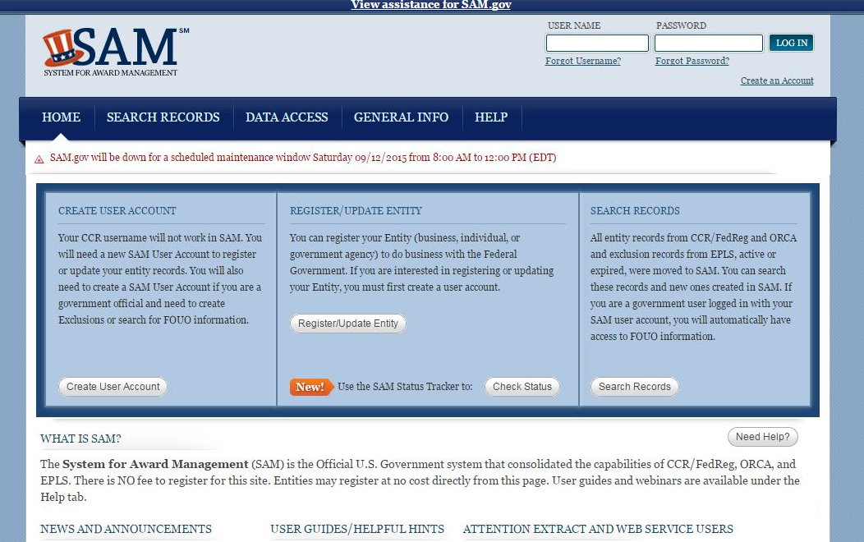
Federal Government
www.sam.gov

Slide 8
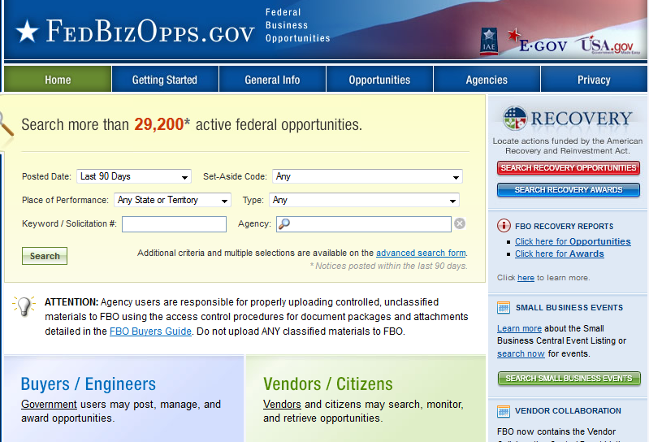
Federal Government
www.fbo.gov

Slide 9
Federal Government
Manufacturing
Department of Defense http://www.acq.osd.mil/mibp/
Construction
US Army Corps of Engineers www.usace.army.mil/CESB/Pages/Default.aspx
US Department of Ag/Forest Service www.da.usda.gov/smallbus/
Naval Facilities http://www.navfac.navy.mil/
Commercial type goods and services
General Services Administration www.gsa.gov
Mixed
Department of Veterans Affairs http://www.va.gov/OSDBU/
Research and development
SBIR-STTR Program www.sbir.gov

Slide 10
Federal Government – targeting local agencies
Department of Veterans Affairs – Milwaukee / Iron Mountain / Chicago
US Forest Service – Rhinelander
Forest Products Laboratory – Madison
Oxford Prison – Oxford
EPA – Chicago
General Services Administration (GSA) – Chicago
Tank Automotive Command (TACOM) – Rock Island
Military Bases
Volk Field – Camp Douglas
Ft. McCoy – Tomah
128th ARW – Milwaukee / 115th Madison
US Army Corps of Engineers – St. Paul / Chicago / Rock Island / Detroit
Naval Station Great lakes – North Chicago – [contracting moving]
ALSO – SOME LARGE CONTRACTORS LIKE Oshkosh Corp and Marinette Marine Corp (looking for small firms)

Slide 11
LARGE COMPANIES
Current Federal Contractors
Small Business Subcontracting Plan
Small – HUBZone – Service-Disabled Veteran – Woman – Disadvantaged
Subcontracting Directories
US SBA ‐ http://www.sba.gov/category/navigation-structure/contracting/contracting-opportunities/sub-contracting
Department of Defense ‐ http://www.acq.osd.mil/osbp/sb/dod.shtml
General Services Administration (GSA) http://www.gsa.gov/portal/content/101195
Use of various disadvantaged business categories is part of Corporate Culture of some large firms
Meetings, interviews, presentations, networking
Marketing materials including business cards, capabilities statement, website and prepared “pitch”

Slide 12
Business Opportunities – State Government

Slide 13
Certification Snapshot
CERTIFICATION BENEFITS: Support Services are available to certified firms free of charge including technical, marketing and financial assistance. WisDOT offers two programs designed to assist DBEs making connections with Prime contractors: Mentor Connection (6-month) and Mentor Protégé (3-year). Mega project goal setting for DBE participation. UCP is a cooperative of Wisconsin cities, counties and airport authorities that benefit from USDOT funding.
ELIGIBILITY REQUIREMENTS: Disadvantaged Status - Belong to an ethnic minority group: Native American, Black, Hispanic, Asian Indian, Asian Pacific or women. Ownership - Be at least 51% owned, controlled, and actively managed by a socially and economically disadvantaged person(s). Small Business Status – Must be a small business as defined by SBA size standard. It must not have annual average gross receipts over $19 million in the three previous years or $40 million for airport concessionaires. Independence – The business must not link to another firm that compromises the applicant’s independence and the disadvantaged owner’s equity. Personal Net Worth – May not exceed $1.32 million (excluding primary residence and ownership in the business).
APPLICATION PROCESS: Contact one of the four certifying members - Wisconsin Department of Transportation, Milwaukee County – Community Business Development Partners, Dane County Purchasing Division- Contract Compliance or City of Madison Department of Civil Rights – Target Business Enterprise Program
Disadvantaged Business Enterprise (DBE)
aka Unified Certification Program (UCP)

Slide 14
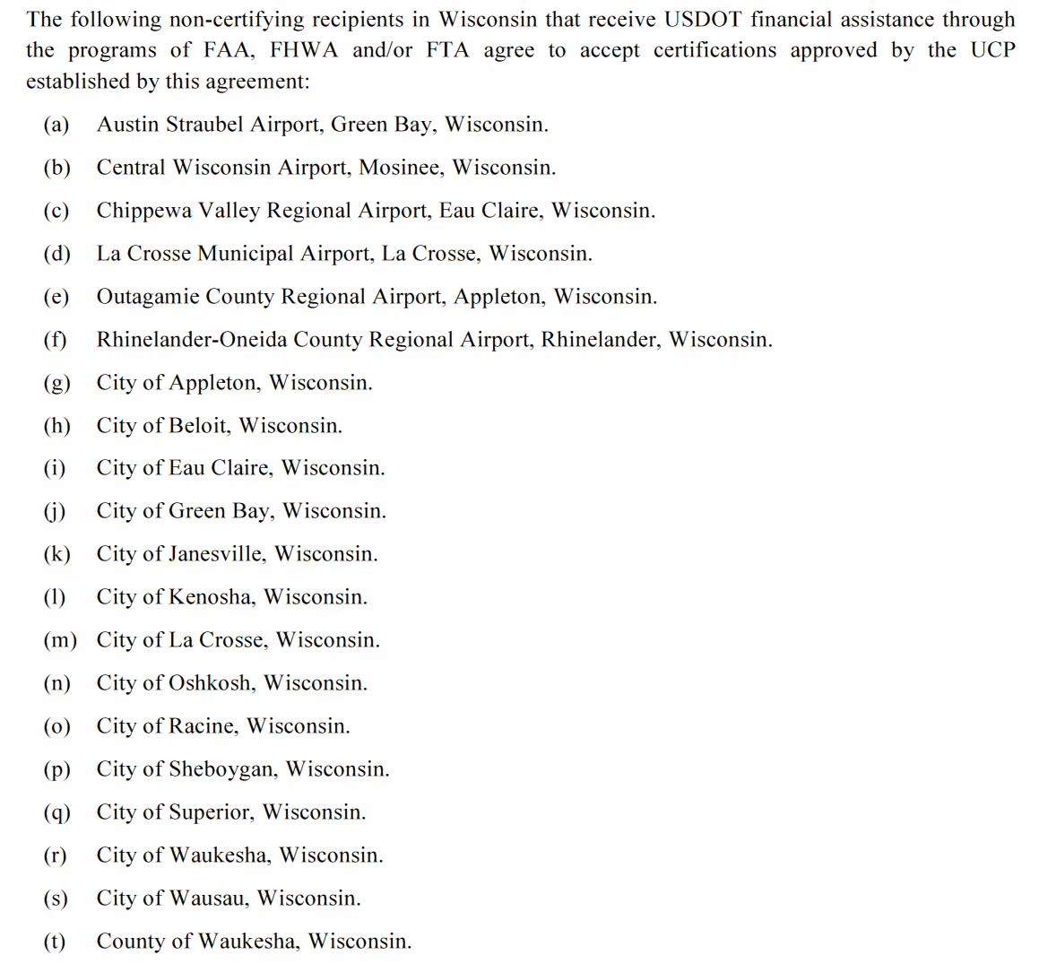
NON-CERTIFYING PARTICIPANTS TO THE WISCONSIN UCP

Slide 15
Certification Snapshot
CERTIFICATION BENEFITS: 5% bid preference on state purchases . 5% MBE utilization goal. All certified firms can participate in Marketplace, a statewide business marketing conference, at discounted rate. Certified firms are also eligible to be listed in the State of Wisconsin's Directory of Minority, Woman, and Disabled Veteran-Owned Businesses which is circulated to corporate buyers and purchasing agents throughout the state.
ELIGIBILITY REQUIREMENTS: Belong to an ethnic minority group: Native American, Black, Hispanic, Asian Indian, Asian Pacific, Aleut, Eskimo, or Native Hawaiian. (The Department does not recognize women as minorities or base eligibility on the gender of an applicant.) Proof of ethnicity and citizenship Be at least 51% owned, controlled, and actively managed by minority group members. Serve a "useful business function" and have customers other than the State of Wisconsin. Must be at least one (1) year old under current ownership.
APPLICATION PROCESS: Review the Pre-Certification Self-Assessment to determine eligibility http://doa.wi.gov/Documents/DEO/Supplier%20Diversity/Pre-Certification%20Assessment.pdf Proceed to https://wisdp.wi.gov/ for online application Upload all supporting documents Follow annual update process Recertification takes place every three years
Minority-Owned Business Enterprise (MBE )

Slide 16
Certification Snapshot
CERTIFICATION BENEFITS: All certified firms can participate in Marketplace, a statewide business marketing conference, at discounted rate. Certified firms are also eligible to be listed in the State of Wisconsin's Directory of Minority, Woman, and Disabled Veteran-Owned Businesses which is circulated to corporate buyers and purchasing agents throughout the state.
ELIGIBILITY REQUIREMENTS: Be at least 51% owned, controlled, and actively managed by women group members. Proof of gender and citizenship for each owner Is currently performing a "useful business function" in the State of Wisconsin. Must be at least one (1) year old under current ownership. Provide a $150.00 application fee made payable to the Department of Administration.
APPLICATION PROCESS: Review the Pre-Certification Self-Assessment to determine eligibility http://doa.wi.gov/Documents/DEO/Supplier%20Diversity/Pre-Certification%20Assessment.pdf Proceed to https://wisdp.wi.gov/ for online application Upload all supporting documents Follow annual update process Recertification takes place every three years
Woman-Owned Business Enterprise (WBE)

Slide 17
Certification Snapshot
CERTIFICATION BENEFITS: 5% bid preference on state purchases . 1% utilization goal was established under 2013 Wisconsin Act 192. All certified firms can receive technical and marketing assistance, including participation in Marketplace, a statewide business marketing conference. Certified firms are also eligible to be listed in the State of Wisconsin's Directory of Minority, Woman, and Disabled Veteran-Owned Businesses which is circulated to corporate buyers and purchasing agents throughout the state
ELIGIBILITY REQUIREMENTS: Be at least 51% owned, controlled, and actively managed by disabled veteran group members. At least 51% majority owner(s) possess U.S. Department of Defense Form DD214 (Certificate of Release or Discharge from Active Duty) to prove service in the Armed Forces. Disabled Veteran document from the Department of Veteran Affairs or discharge paper from the branch of armed service, stating service connected disability rating under 38 USC 1114 or 1134 of at least 20%. At least 51% majority owner(s) are residents of Wisconsin and the business has its principal place of business in Wisconsin. Is currently performing a "useful business function" in the State of Wisconsin. Must be at least one (1) year old under current ownership. Provide a $150.00 application fee made payable to the Department of Administration.
APPLICATION PROCESS: Review the Pre-Certification Self-Assessment to determine eligibility http://doa.wi.gov/Documents/DEO/Supplier%20Diversity/Pre-Certification%20Assessment.pdf Proceed to https://wisdp.wi.gov/ for online application Upload all supporting documents Follow annual update process and Recertification takes place every three years
Disabled Veteran-Owned Business Enterprise (DVB)

Slide 18
STAR IMPLEMENTATION UPDATE
State Transforming Agency Resources (STAR)
Replace 120+ different administrative systems
Provide standardization between state agencies
Tentative implementation schedule:
October 2015 – Uploading existing vendors from VendorNet to STAR (will include all vendors received contract and/or payment from the state within the past 18 months)
January 2016 – STAR and VendorNet 2.0 will be operational

Slide 19
STAR IMPLEMENTATION EXCEPTIONS
WisDOT’s implementation is scheduled for summer 2016
UW will stay on SHOP@UW and use VendorNet 2.0 to post contract opportunities
All Muni’s will continue to use their own systems and use VendorNet 2.0 to post contract opportunities

Slide 20
CONTACT INFORMATION
STAR: http://STARPROJECT.WI.GOV/HOME
VendorNet: (608) 264-7897 / (800) 482-7813
http://vendornet.state.wi.us/vendornet/default.asp
General Procurement Information http://www.doa.state.wi.us/divisions/enterprise-operations/state-bureau-of-procurement/soliciation

Slide 21
Business Opportunities – Local Government

Slide 22
COUNTY / MUNICIPAL GOVERNMENT CERTIFICATIONS

Slide 23
COUNTY / MUNICIPALITY Certifications
Organization Type | Certification | Agency | Website
County | ACDBE DBE ESB MBE WBE DBE Section 3 Target Business | Milwaukee County Dane County | County.milwaukee.gov/cbdp/certificationservices.htm www.danepurchasing.com/contract_compliance.aspx
Municipality | SBE Target Business Certification Program | City of Milwaukee City of Madison | city.milwaukee.gov/OSBD#.U0rvgIko9jr https://www.cityofmadison.com/dcr/documents/TargetedBusCertPgm.pdf
Other Entities | HUB SWMBE DBE | Milwaukee Public School Milwaukee Metropolitan Sewage District Milwaukee County Transit System | http://www.milwaukee.k12.wi.us/portal/server.pt/comm/departments/338 http://www.mmsd.com/procurement/SWMBE.aspx http://www.ridemcts.com/Doing-Business-With-MCTS/dbe-support

Slide 24
PRIVATE CERTIFICATIONS

Slide 25
PRIVATE Certification
Organization Type | Certification | Agency | Website
Large Corporations | Company Internal Supplier Diversity Initiative | North Central Minority Supplier Development Council– Fee $300 - $750 based on revenue size $250 - $500 annual recertification fee Women’s Business Enterprise National Council (WBENC) – Fee $350 - $950 based on revenue size $350 - $950 annual renewal fee | http://www.northcentralmsdc.net/MbeCertification/Certification www.wbenc.org/certification/

Slide 26
Business Opportunities – Tribal Government
Dr. Nicole Bowman, President, Bowman Performance Consultant (Video)
Notes:
DR. NICOLE BOWMAN (Mohican/Munsee) is the President/Founder of the nationally award winning Bowman Performance Consulting (BPC) in Shawano, WI. Bowman Performance Consulting (BPC) is a professional consulting and scientific research & evaluation company. WI BPC provides services to a national clientele from the public, private, non-profit and tribal sectors. BPC gathers measurable and meaningful data from clients and their stakeholders/customers so that individuals, programs, and organizations can use the data, improve performance, and build capacity from their value-added services in order to function more efficiently and effectively for the short and long-term. BPC services fall under four main categories: research, development, implementation, and evaluation.

Slide 27
Business Opportunities – Tribal Government
Dr. Nicole Bowman, President, Bowman Performance Consultant
Notes:
*** Note: Recording was prior to the new Marketplace 2015 logo

Slide 28
Strategic Plan –Moving Your Business Forward
Gene Wright, Graduate Management Program Director, MSOE (Video)
Notes:
Gene Wright - Currently Gene serves as the Program Director for the MS- Engineering Management, MS- New Product Management, and MS-Export Management. Milwaukee School of Engineering is a private, non-profit university offering bachelor’s and master’s degrees in engineering, business, mathematics and nursing. At MSOE, you will find a caring community of students and faculty. MOSE is committed to fostering a higher standard of academic programming and research, and personalized service, instruction and guidance.

Slide 29
Strategic Plan – How Can Your Business Move Forward
Gene Wright, Graduate Management Program Director, MSOE

Slide 30
Overcoming Obstacles – Finance
Dave Kircher, Senior Vice President, Wisconsin Business Development (Video)
Notes:
David Kircher has been with WBD for over 19 years. WBD Finance Corp. is an independent, not for profit, statewide Certified Development Company with 8 offices located throughout the state to serve the entire State of Wisconsin. WBD assists commercial lenders and their business clients obtain financing and other business assistance, utilizing Federal, State and Local Government Economic Development Agencies, Programs and Resources

Slide 31
Overcoming Obstacles – Finance
Dave Kircher, Senior Vice President, Wisconsin Business Development

Slide 32
Break

Slide 33
Overcoming Obstacles – Building Capacity
Jean Thiel, President, Belonger Corporation (Video)
Notes:
Belonger Corporation Inc. is an S-Corporation with the State of Wisconsin. Belonger is woman, and minority owned and operated, and is also a small business concern. Belonger Corporation is a complete mechanical contractor in the specialty trades industry, providing H.V.A.C./R. commercial and industrial applications. They offer complete installation and service of boilers, furnaces, air handling equipment, rooftops, pneumatics and electronic controls, air conditioning, refrigeration, chillers, and process equipment.

Slide 34
Overcoming Obstacles – Building Capacity
Jean Thiel, President, Belonger Corporation

Slide 35
Overcoming Obstacles - Performance
Manisha Dotson, President, The Nisha Group llc.
Notes:
Manisha Dotson, President, The Nisha Group LLC. – The Nisha Group LLC has been offering quality facility maintenance services since 1999. And armed & unarmed security guard services since 2004. Nisha Group serves city county, Federal Government sectors as well as private industrial and commercial markets. The Nisha group is a woman owned small business and 8(a) certified.

Slide 36
Overcoming Obstacles – Fear of the Unknown
Manisha Dotson, President, The Nisha Group LLC.

Slide 37
Overcoming Obstacles – Sales and Marketing
Brigette Brietenbach, President, Company B (Video)
Notes:
Brigette Breitenbach is the founder and owner of Company B Brand Development, a full-service marketing communications firm based on Milwaukee. Serving clients in the hotel and food & beverage industries, Brigette's team focuses on the vehicles that create the most value for her clients: websites, email marketing, social media, PR and eye-catching design. Brigette has started two companies and is an investor in several hospitality endeavors. She holds a journalism degree from the University of Wisconsin – Madison and believes the ability to communicate, write and sell yourself are the keys to successful entrepreneurship.

Slide 38
Overcoming Obstacles – Sales and Marketing
Brigette Brietenbach, President, Company B

Slide 39

SBA Resources
Frank Demarest, Deputy District Director, US SBA

Slide 40
Overview
Created: 1953
Mission: …aid, counsel, assist and protect the interests of small business concerns…
Federal: Free…
Resources: Programs and Partners
Network
And much more

Slide 41

SBA WI DO Resource Guide
-Broken out into three primary sections:
Counseling
Capital
Contracting
-National overview with WI specific info
-Other content
-Updated annually
-Available:
Online at www.sba.gov/wi
Hard copy

Slide 42
Counseling
Extensive network of resource partners Counseling services & classes free or low cost
More than 19,000 served in Wisconsin in 2014
SCORE with locations throughout WI
SBDC’s (12 with locations at UW extensions)
Women’s Business Centers with various locations
To locate offices near you: www.sba.gov and click on “get local assistance”

Slide 43
Contracting
What are the Government-wide Small Business Contracting Goals and Achievement?
Category | Goal | 2012 | 2013 | 2014
Small Business | 23% | 22.25% | 23.39% | 24.99%
SDB (8(a)) | 5% | 8% | 8.61% | 9.46%
HUBzone | 3% | 2.01% | 1.76% | 1.82%
Women | 5% | 4% | 4.32% | 4.68%
SD Vets | 3% | 3.03% | 3.38% | 3.68%

Slide 44
Contracting
Government-wide Small Business Contracting
Goals are a floor—not a ceiling!
In 2014:
$91.6 Billion to Small Business
$3.6+ in Wisconsin
DoD Largest Purchasing Entity

Slide 45
Contracting Programs
Federal: 8(a) Business Development
HUBZone
WOSB/EDWOSB
SDVOSB
HUD Section 3
State
Municipality
Others

Slide 46
Contracting Resources
SBA HUBZone Help Desk and the WI DO
HUD
DoD
Forestry Dept
City and County Contracting Offices/Reps
Wisconsin Procurement Institute
SAM
Certifications
RFQ’s/Bids/Proposals
MORE!!

Slide 47
Capital
Some of the Various SBA Programs Available:
7a
Express
Export
Seasonal CAPlines
Contract CAPlines
504
Microloan

Slide 48
Capital Resources
Banks and Credit Unions dealing with SBA Programs
Community Advantage Lenders
Certified Development Centers
Microloan Intermediaries

Slide 49
Surety Bonds
Three Types
Bid Bond: Guarantees that the bidder on a contract will enter into the contract and furnish the required payment and performance bonds if awarded the contract.
Payment Bond: Guarantees that suppliers and subcontractors will be paid for work performed under the contract.
Performance Bond: Guarantees that the contractor will perform the contract in accordance with its terms and conditions.* (*The term Final Bond means Payment Bond, Performance Bond or both Payment and Performance Bond.)
SEE SBA WI DO RESOURCE GUIDE FOR LIST OF AGENTS

Slide 50
Surety Bonds Changes
Surety Bonds raised from $2 million to $6.5 million
For Federal Contracts with the contracting office stating a need the limit is raised to $10 million.
NEW in 2014: Expedited processing for bonds $250,000 and less

Slide 51
Training
Over 100 free online courses at SBA.gov
Business planning
Finance
Marketing
Government contracting-14 courses with multiple sessions
Free webinars and call in sessions
Entrepreneurial education classes (targeted audiences)
V-Wise (women veterans)
Boots to Business: Reboot—includes all veterans; locations TBD for 2016
Emerging Leaders (Urban CEOs)-in progress now

Slide 52
SUPPLEMENTAL
INFORMATION

Slide 53
Mentor Protégé
Formal relationship between larger firm and protégé firm to leverage federal contracting opportunities. Began in the 8 (a) program; recently expanded.
Benefits:
Technical and management assistance for protégé
Prime contracting--Mentors can enter into joint-venture arrangements with protégés to compete for government contracts.
Financial assistance-equity or loans--Mentors can own equity interest up to 40% in protégé
Qualification for other SBA programs--A protégé can obtain other forms of SBA assistance as the result of its good standing in the Mentor-Protégé program.

Slide 54
HUBzone Program-Eligibility
Meet small business size standards
Owned/controlled by:
51% U.S. citizens
CDC
Agricultural cooperative
Indian tribe
Principal office in a HUBzone
35% of employees living in a HUBzone

Slide 55
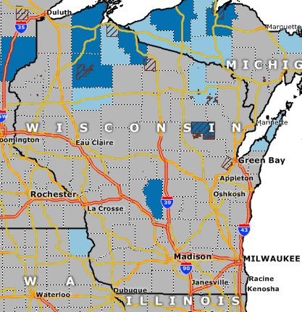
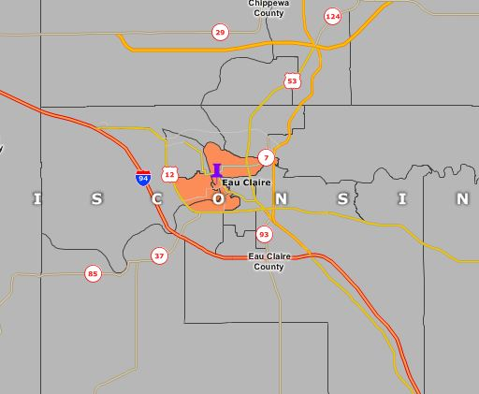
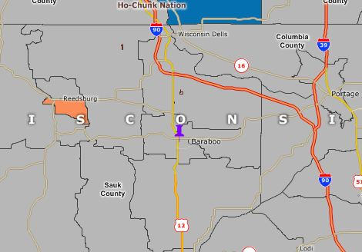
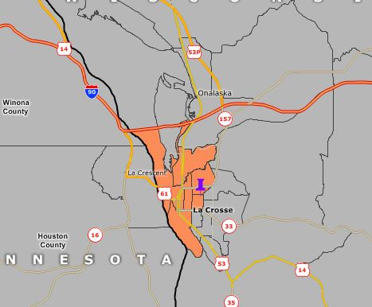
HUBzone Maps
www.sba.gov/hubzone
Eau Claire
Baraboo
La Crosse

Slide 56
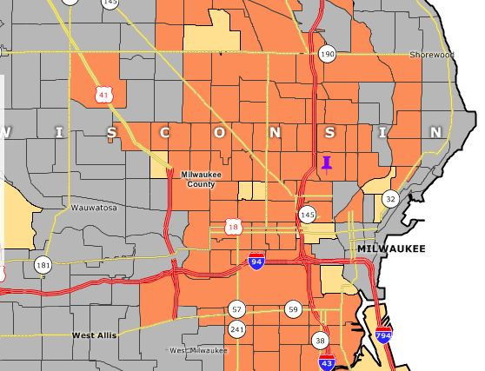
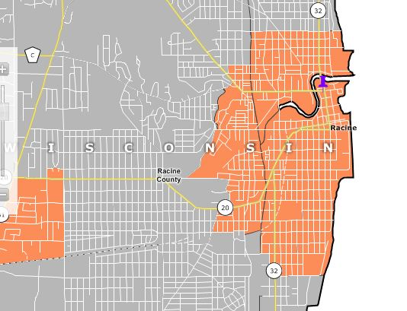
HUBzone Maps
Milwaukee
Racine
www.sba.gov/hubzone

Slide 57
WOSB Program-eligibility
At least 51% directly owned by women who are U.S. citizens
No limits on ownership
Women manage day to day operations
EDWOSB-above plus:
Personal net worth less than $750,000
AGI $350,000 or less
Market value of assets less than $6 million

Slide 58
WOSB Program-certification
Self certification-by WOSB or EDWOSB
Registration in SAM required
Contracting officer may request documentation
Docs maintained in program repository
Third party can certify:
Federal or state agency or SBA approved 3rd party
8 (a) certification may be eligible

Slide 59
SDVOB Eligibility
Business owned by a Service-Disabled Veteran (SDV)
51% direct and unconditional ownership by one or more SDVs
Control of the business
Long-term decisions, daily business operations, management controlled by SDV(s)
Ultimate control of the business entity (partnership, LLC, corporation) by SDV(s)
SDV must have:
Management experience to run the concern
Ultimate managerial, supervisory control of technical experts, license holders
SDV need NOT have technical expertise or license

Slide 60
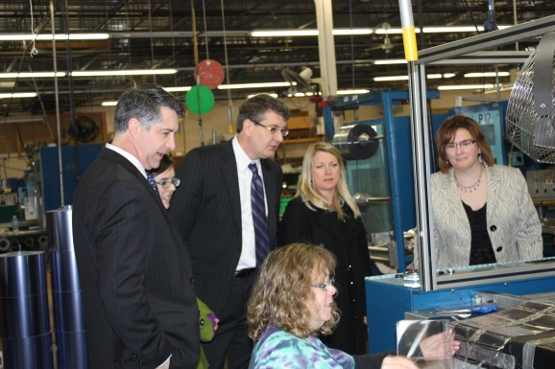
7(a) Loan Program
SBA’s primary business loan program
Broad eligibility requirements
Wide range of financing needs
Increase in the maximum 7(a) loan amount to $5MM, guaranty amount to $3.75MM.
Maximum guaranty 85% up to $150k
Maximum guaranty 75% over $150k

Slide 61
Express Loans
50% Guarantee
Up to $350,000
Includes Lines of Credit
Lender makes credit decision
Up-front fees waived for vets

Slide 62
Wisconsin Offices
MILWAUKEE
310 W. Wisconsin Avenue, Suite 400
Milwaukee, WI 53203
Phone: 414-297-3941
Email: wisconsin@sba.gov
MADISON
740 Regent Street, Suite 100
Madison WI 53715
Phone: 608-441-5261
Email: wisconsin@sba.gov

Slide 63

MARKETPLACE is the premier business capacity building conference of the year for minority, women and veteran-owned companies to learn how they can do business with state, federal and local agencies as well as corporations. These markets represent billions of dollars of annual purchasing, with special programs to include minority, women, veteran and disadvantaged business owners. For more than 30 years, this conference has provided opportunities for businesses to meet with potential buyers, identify funding sources, connect with business assistance resources and build their capacity.
MarketplaceWisconsin.com

Slide 64
Governor’s Conference on Minority Business Development
Welcoming minority, women and veteran-owned businesses
October 29, 2015
Free Workshops
Reception
October 30, 2015
Breakfast for Champions
Exhibit Hall
Buyer Meetings
Keynote – Baly Ambegaoker, President, Centerpoint Inc.
Networking Opportunities
Governor's Award Luncheon

Slide 65
Questions?

Slide 66
AND THE WINNER IS…

Slide 67
Assistance:
Wisconsin Procurement Institute
Joseph Smetak, CFCM
(414)270-3600
josephs@wispro.org
www.wispro.org

